Slide 1
Lecture 7
Sept. 13th ,2019
Great job in Lab! Slides for both mitosis and meiosis will remain in the lab for your use.
Lab quiz/practical Thursday, Sept. 19th
Exam 1 Monday, Sept. 16th.
Topics today
Problem set linked today—solution posted Sunday.

Slide 2
Where were we?
  Meiosis
  Mechanics and the details of phrophase I

Slide 3
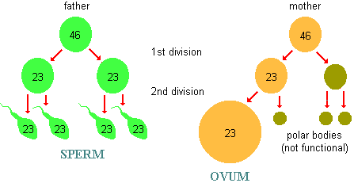
Some differences in male and female gametogenesis (see handouts given in lab)
2N
2N
N N
N N

Slide 4
More differences…
In some animals, female gametogenesis is also discontinuous. Human females go through meiosis 1 just before ovulation and complete meiosis after fertilization!

Slide 5
Meiosis creates gametes with genetic variability
How?—We assume that each person inherited different alleles (different forms of one gene) from their parents for at least some of their genes. In the process of meiosis 2 mechanisms shuffle those alleles into new gametes.
  1. Random alignment of homologs---independent assortment, creates unique combinations of maternal and paternal chromosome in each gamete.
  2. Physical exchange of DNA between maternal and paternal homologs (crossing over with non-sister chromatids) creates entirely new combinations of alleles on each chromosome.

Slide 6
Basic concept of probability
Number of combinations when 2 possibilities exist for each individual item = 2^{n}
(Coins represent 2-possibility situations)
For n=3 chromosomes, gametes can have 2³ =8 unique combinations of chromosomes

Slide 7
How many unique combinations of maternal and paternal chromosomes can occur in human egg/ova and sperm? n=23
2²³ = 8, 388, 608 combinations in gametes (gametic combinations)!!
Translation? The eggs and sperm you make, combine your mom’s and your dad’s homologous chromosomes in over 8 million combinations.

Slide 8
How may different types of zygotes can be formed when human sperm and ova fuse?
2²³ (sperm) X 2²³(ova) = 2⁴⁶
(gametic combinations) (gametic combinations)
~ 7 X 10¹³ zygotic combinations!

Slide 9
Crossing over creates more variation
Recall that the pairing of homologs during prophase I facilitates the exchange of portions of each homolog.
So the chromosomes you receive from your parents are combined in unique ways before they are distributed to your gametes.

Slide 10
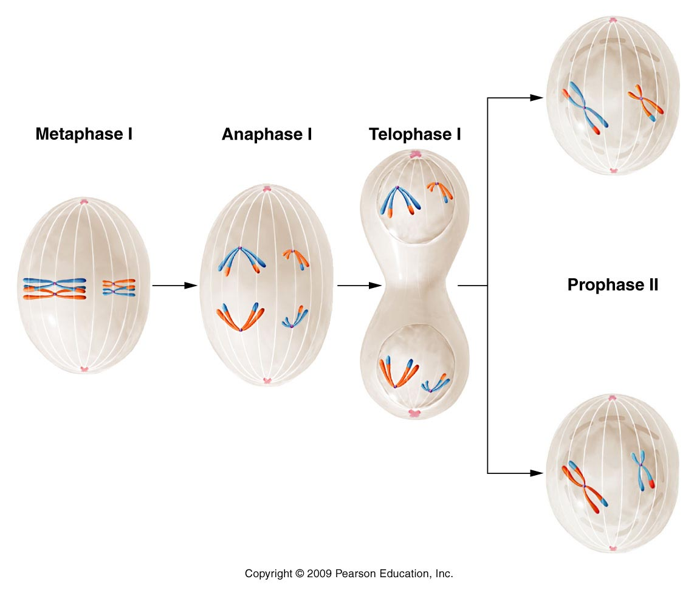
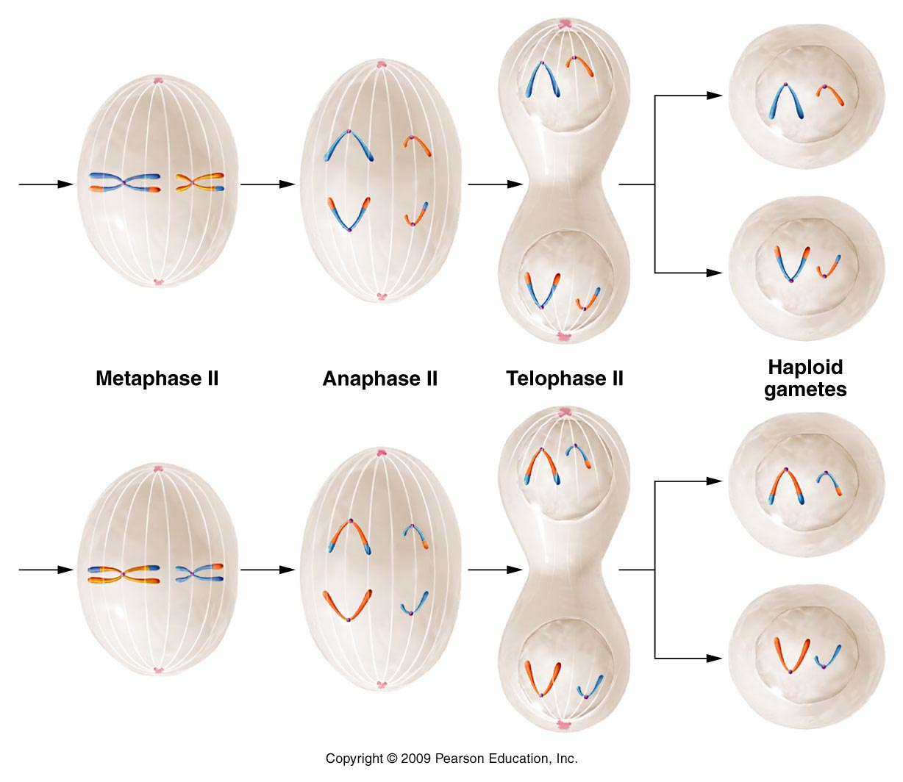
The chromosomes in gametes are mixtures of the homologous pairs in somatic cells.
Figure 2.10
Notes:
10
Figure 2-10 The major events in meiosis in an animal with a diploid number of 4, beginning with metaphase I. Note that the combination of chromosomes in the cells produced following telophase II is dependent on the random alignment of each tetrad and dyad on the equatorial plate during metaphase I and metaphase II. Several other combinations, which are not shown, can also be formed. The events depicted here are described in the text.

Slide 11
You should be convinced at this point that the process of meiosis ensures that offspring will have unique combinations of alleles.
Why is this important?

Slide 12
Genetic variation provides the opportunity for survival of some members of the species when challenged by environmental stresses.
Asexually reproducing organisms (like bacteria) do not have this advantage. Each generation is a genetic clone of the last.
  (there are other ways they can acquire some genetic variability)

Slide 13
Occasionally mistakes occur during meiosis…
Chromosomes can fail to separate properly
  In Meiosis I or in Meiosis II
  In males (forming sperm)
  In females (forming egg)
  Failure of chromosome separation is called:
  Non-disjunction
  (Focus of 8.1-8.3)

Slide 14
Is this a big deal?
If the gamete is “chosen” during fertilization, the zygote will have an abnormal number of chromosomes.
Cannot have normal development with an abnormal number of chromosomes. Most embryos with aneuploidy (a chromosome number other than the normal 2N) fail to develop to term—results in fetal death/misscarriage)
Syndromes like Down syndrome and Turner syndrome are the result of non-disjunction during gamete formation.

Slide 15
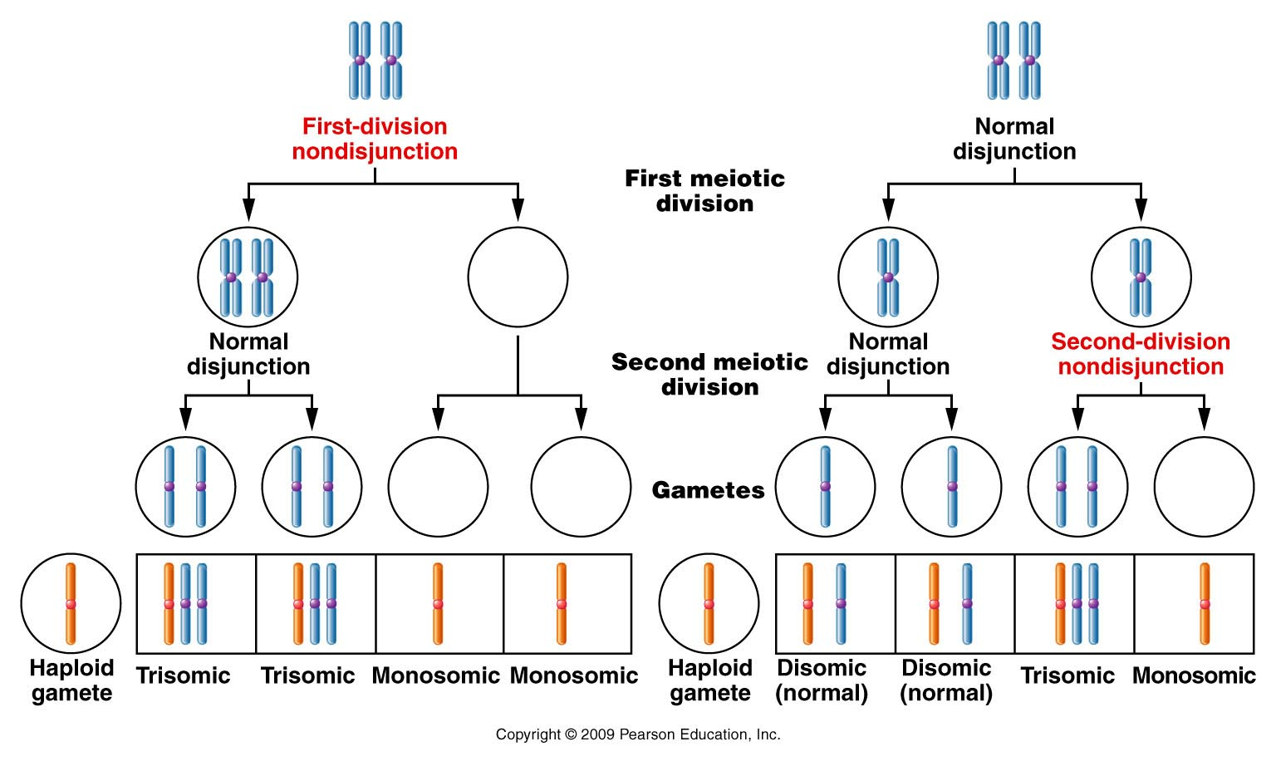
Figure 8.1
Notes:
15
Figure 8-1 Nondisjunction during the first and second meiotic divisions. In both cases, some of the gametes formed either contain two members of a specific chromosome or lack that chromosome. Following fertilization by a gamete with a normal haploid content, monosomic, disomic (normal), or trisomic zygotes are produced.

Slide 16
Sex / fertilization
Zygote/new organism
Zygote/new organism
Figure 8.1
Notes:
16
Figure 8-1 Nondisjunction during the first and second meiotic divisions. In both cases, some of the gametes formed either contain two members of a specific chromosome or lack that chromosome. Following fertilization by a gamete with a normal haploid content, monosomic, disomic (normal), or trisomic zygotes are produced.

Slide 17
Terminology
Anueploidy---gain or loss of 1 or more chromosomes, but not a complete set (result of non-disjunction).
2 common types
  Trisomy (2n +1)= number of chromosomes in the cell
  Monosomy (2n-1) = number of chromosomes in the cell

Slide 18
Rare cases of aneuploidy with full-term development
(Normal human [46, XX ]or [46, XY])
Down syndrome (Trisomy 21)
  Designation (47, +21)
  Patau syndrome (Trisomy 13)
  47, +13
  Edwards syndrome (trisomy 18)
  Turner syndrome (monosomy X)
  45, X
  http://www.turnersyndromefoundation.org
Physical resemblance, physical and mental developmental delays, heart malformation
Both show severe physical malformations, survive 3-4 months
Physically female, shorter, webbed neck, sometimes mental delays/malformations
Notes:
18

Slide 19
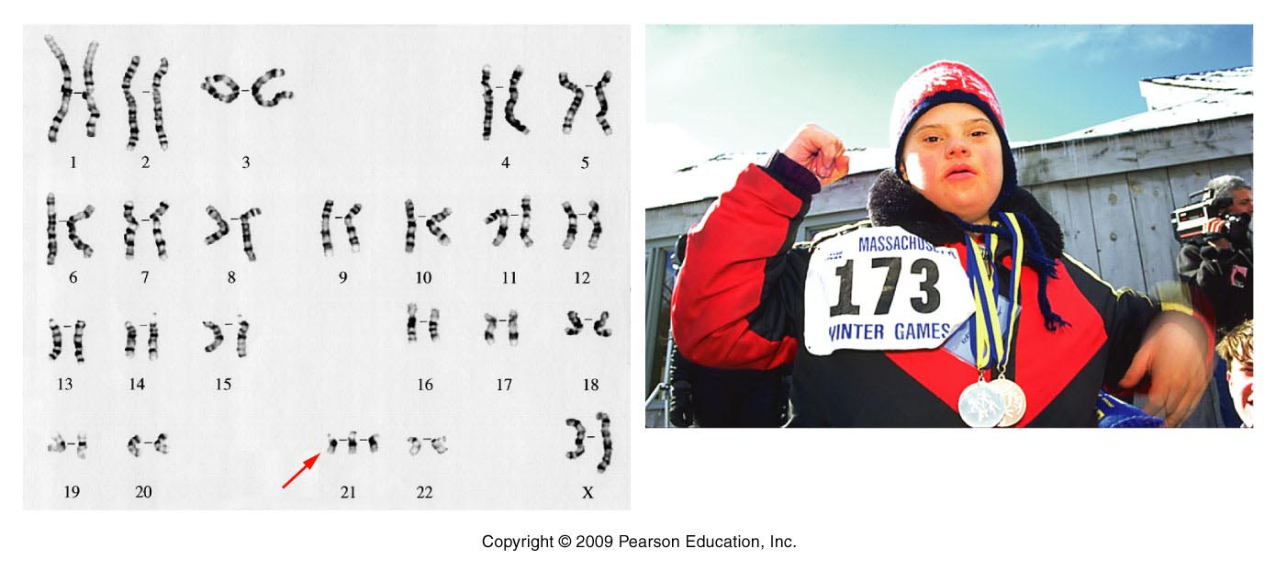
Figure 8.4
Notes:
19
Figure 8-4 The karyotype and a photograph of a child with Down syndrome. In the karyotype, three members of the G-group chromosome 21 are present, creating the 47,21+ condition.

Slide 20
What, on chromosome 21, causes Down Syndrome?
Still largely unknown but the important region of chromosome 21 has been narrowed to a region called DSCR (Down Syndrome Critical Region). DSCR is the locus for more than one gene. See paper linked to website.
Surprisingly, 3 copies of DSCR is protective for some types of cancers. People with DS have ~10% reduction in death from cancer compared to the general population!

Slide 21
Critical thinking…
Based on previous lectures…Propose a hypothesis to explain the reduced incidence of cancer in individuals with Down Syndrome.
Explain your hypothesis thoroughly

Slide 22
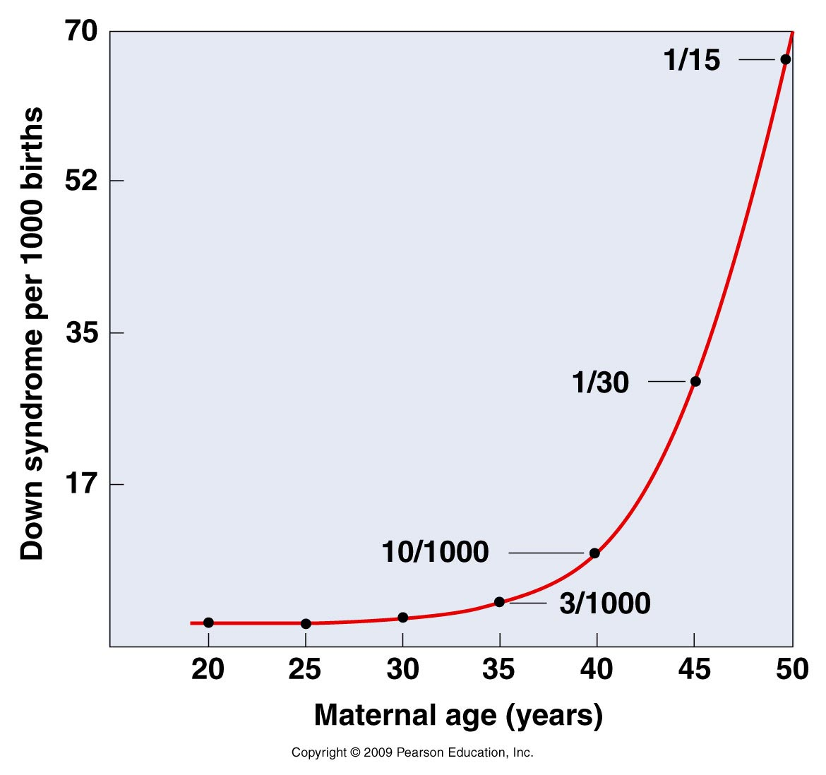
Non-disjunction (as observed frequency of these syndromes--- seems to increase with age of the parents)
Figure 8-5
Notes:
22

Slide 23
Age of the father is also a significant risk factor for Down Syndrome. (Summary of one 2003 study)
Among older mothers over 40, researchers found that an increase of 50% in Down syndrome risk was attributable to the advanced age of the father.
In fact, researchers suggest that there is only a modest increase in Down syndrome risk for women 35-39 compared with women 30-35 years old, but the dramatic increase in Down syndrome births among women 35 to 39 years old is largely due to the influence of older fathers because older women tend to make babies with older men.

Slide 24
Partial aneuploidy
Sometimes only part of a chromosome is present in abnormal numbers.
You might see an extra p or q arm of a particular chromosome.
  i.e. trisomy 6q or trisomy 4p

Slide 25
Down syndrome can occur if part of chromosome 21 is present in an extra copy
The DSCR is duplicated and fused to chromosome 22

Slide 26
Also---It’s important to understand that aneuploidy can occur in select somatic cells with little or serious effect. (as opposed to germline aneuplody which affects every cell).
  A hallmark of cancer cells is highly abnormal chromosomes—extra, missing, or rearranged chromosomes…which alter genes associated with cell cycle regualtion.

Slide 27
A second example of abnormal number of chromosomes is called:
Euploidy
  Having extra complete sets of chromosomes
  (if more than the normal amount=polyploidy)
  2n (normal for somatic cells) =diploid
  3n=triploid
  4n=tetraploid
  *common in some tissues of plants, but not in many animal species (some lizards, amphibians, fish)
Notes:
27

Slide 28
How can euploidy happen?
Replication of chromosomes, without cell division.
Failure of all chromosomes to segregate during meiosis---creating 2n gametes. Followed by fertilization with normal gametes.
  Forms triploid zygote.
Notes:
28

